Slide 1
Web Security
Waqar Yar

Slide 2
Security Domains in Servlets
Authentication
Authorization
Confidentiality
Data Integrity.

Slide 3
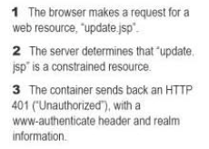
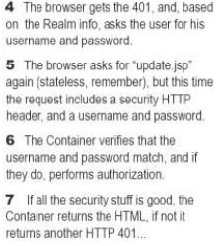
Authentication in HTTP World

Slide 4
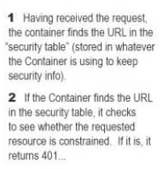
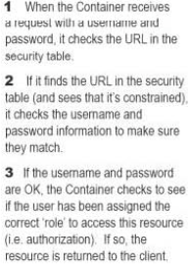
Container Steps

Slide 5
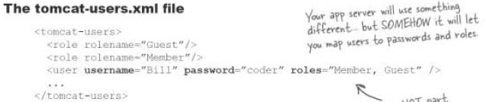
The Security Realm
Realm is where authentication information is stored
In Tomcat it’s the ‘tomcat-users.xml’ file.
This file is loaded into memory and is applicable to all web apps.

Slide 6
Enabling Authentication
To enable authentication you can add the following lines in the DD:
<login-config>
<auth-method>BASIC</auth-method>
</login-config>

Slide 7
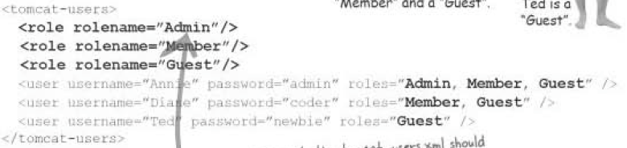
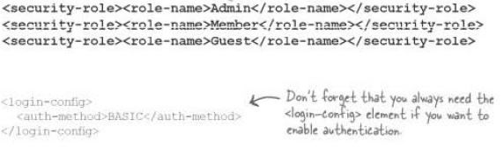
Authorization Step1: defining roles
In the Users file define the roles and users.
In the DD:

Slide 8
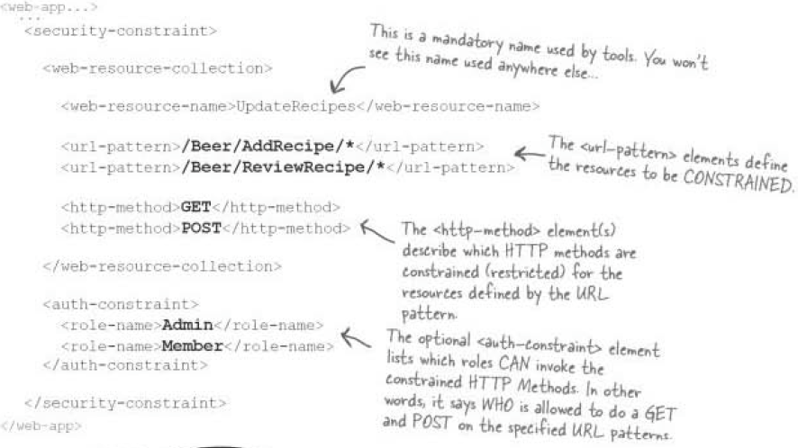
Authorization Step2: defining resources\method constraints

Slide 9
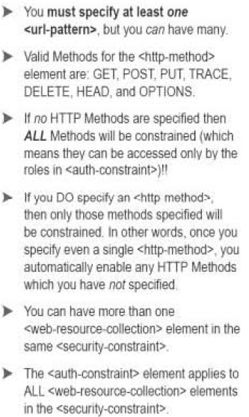
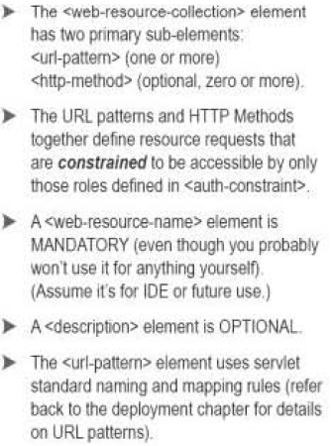
Web Resource Collection

Slide 10
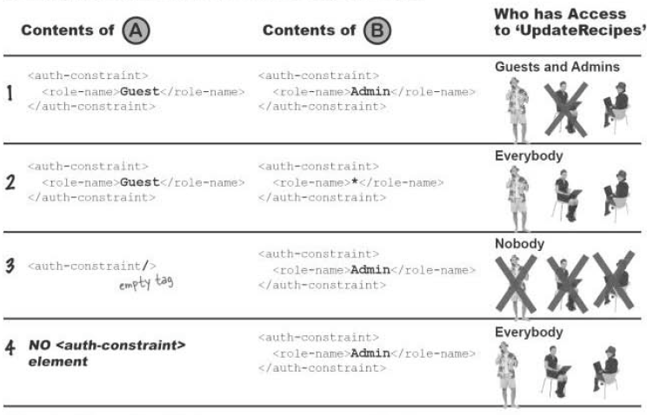
Rules of <auth-constraint>

Slide 11
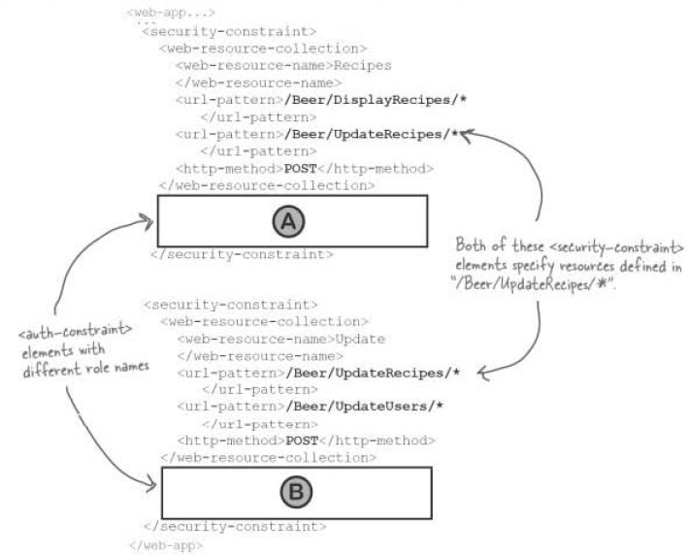

Slide 12
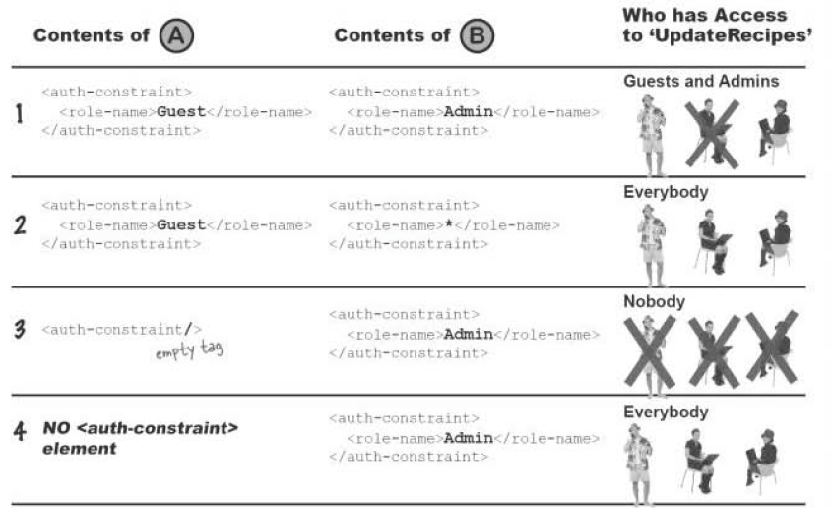

Slide 13
Authentication
Following are the four types of Authentication which can be configured:
BASIC
DIGEST
CLIENT-CERT
FORM

Slide 14
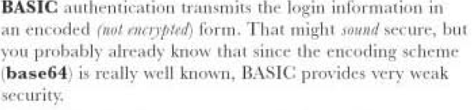
BASIC

Slide 15
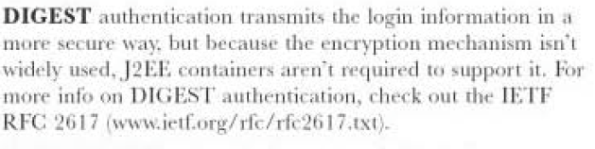
DIGEST

Slide 16
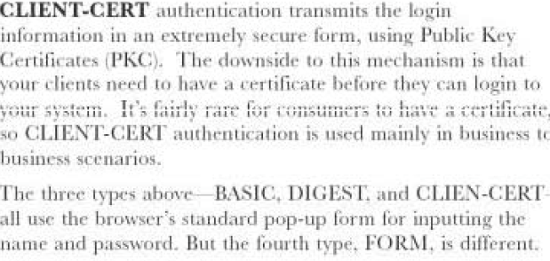
CLIENT-CERT

Slide 17
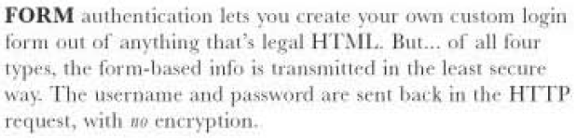
FORM

Slide 18
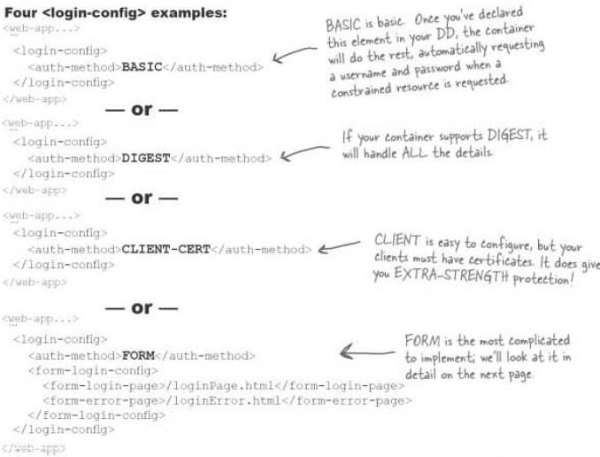

Slide 19
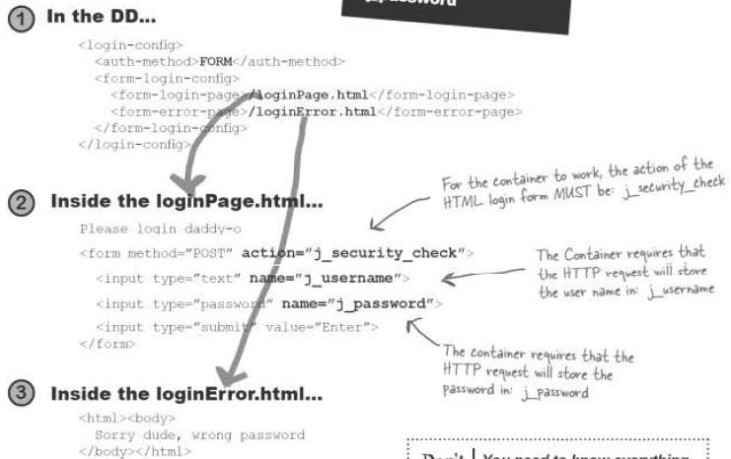
Example

Slide 20
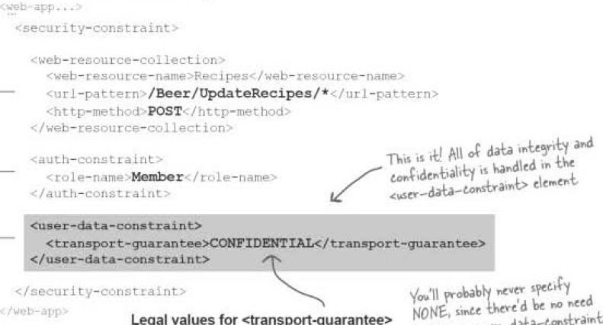
Data Confidentiality and Integrity

Slide 21
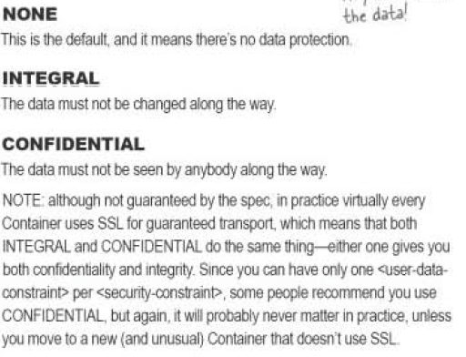
Data confidentiality options

